Slide 1
Employee Data Analysis using Excel
STUDENT NAME : valliammal.k
REGISTER NO :312214964
DEPARTMENT : B.com G
COLLEGE : Annai veilakanni’s for women college

Slide 2
PROJECT TITLE
Employee Performance Analysis using Excel

Slide 3


AGENDA
Problem Statement
Project Overview
End Users
Our Solution and Proposition
Dataset Description
Modelling Approach
Results and Discussion
Conclusion
3/21/2024 Annual Review

Slide 4

PROBLEM STATEMENT
Accurately evaluate employee performance
Idntify strengths, weaknesses, opportunities and threats(SWOT analysis)
Develop targeted interventions and training programs
Inform talent management decisions (department salary, employee ID).

Slide 5

PROJECT OVERVIEW
Analysis employee performance data to identify of performance and areas for improvement
Develop data- driven insights to inform talent management programs and leadership development initiatives
Focus on identifying of performance , area of and opportunities for growth and development.
Name , department, salary,,,.

Slide 6

WHO ARE THE END USERS?
Name
Department
Salary
Compensation and benefits teams
Employees
Organizational development teams

Slide 7

OUR SOLUTION AND ITS VALUE PROPOSITION
Solution : Empower AI – employee performance insights.
Value proportion:
Identify top performer
Salary
Department
Employee ID

Slide 8
Dataset Description
Description : This data set contains information on employee performance ,demographics ,and development activities
Fields:
Employee ID
Name
Department
Salary
Fite

Slide 9

3/21/2024 Annual Review
9

Slide 10
10

Slide 11
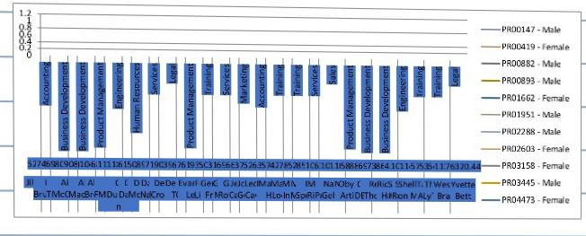
RESULTS
11

Slide 12
conclusion
Employee performance analysis is a critical component of talent , enabling organizations to make data driven decisions ,drive business outputs and enhance employee experience. By leveraging advanced analytics section was separate.

